Slide 1

Visual Basic.NET Using Procedures

Slide 2
ROAD MAP
Appearance of Forms
Properties of Form Control
Loading and Showing Forms
Designing Menus
Manipulating Menus at Runtime
Building Dynamic Forms

Slide 3
Appearance of Forms
Application is made up of
one or more forms
usually more than one
Main characteristic:
title bar
form’s caption

Slide 4
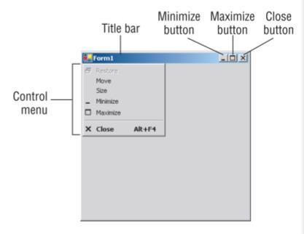
The Elements of the Form
Example:

Slide 5
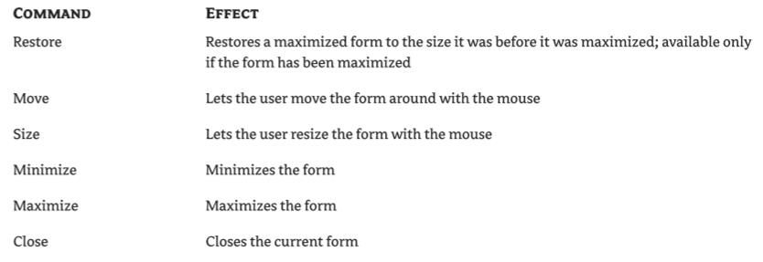
Commands of the Control Menu

Slide 6
Properties of the Form Control
Accept Button, Cancel Button
Auto Scale
Auto Scroll
Border Style
Control Box
Minimize…, Maximize…
Size Grip Style
Start Position
Top, Left
Top Most
Width, Height

Slide 7
Loading and Showing Forms
The Startup Form
A typical application has more than a single form
Controlling One Form from within Another
Sharing Variables between Forms
Forms vs. Dialog Boxes
The Multiple Forms Project

Slide 8
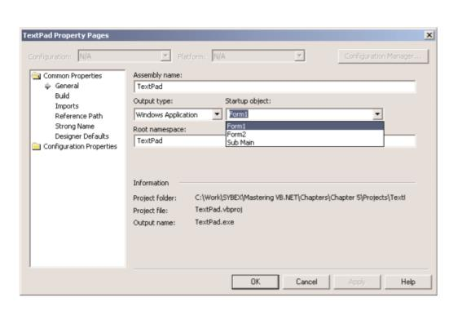
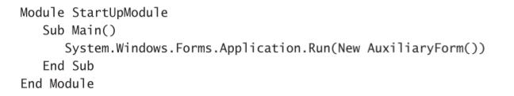
The Startup Form
Specify the form that’s displayed when the application in the properties window
Or start an application with a subroutine without loading a form.
Then open the Project Properties dialog box and specify that the project’s startup object is the subroutine Main().

Slide 9
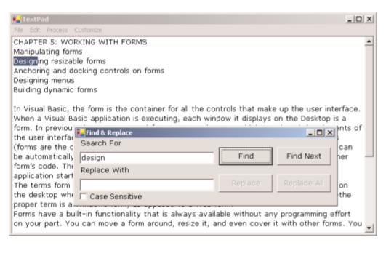


Controlling One Form from within Another
The Find & Replace form acts on the contents of a control on another form.
Sharing Variables between Forms
via public variables.
FRM is a variable that references the form in which the public variables were declared.

Slide 10
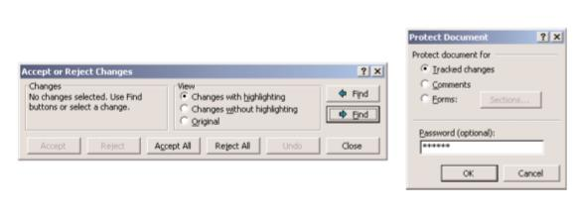
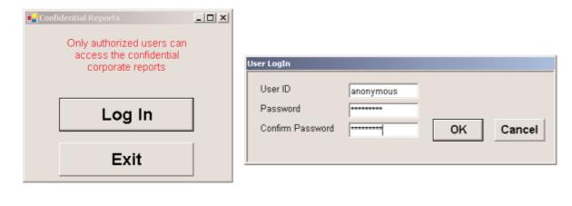
Forms vs. Dialog Boxes
Dialog boxes
special types of forms with rather limited functionality
we use it to prompt the user for data
Typical dialog boxes used by Word
A simple dialog box that prompts users for a username and password

Slide 11
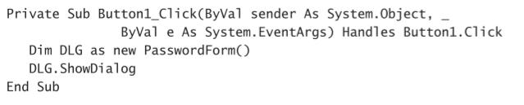
Initiate a dialog box from within another form’s code
The process of displaying a dialog box is no different than displaying another form.
Enter the following code in the event handler from which you want to initiate the dialog box:

Slide 12
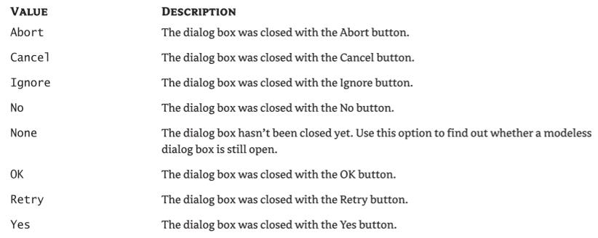
The Dialog Result Enumeration

Slide 13
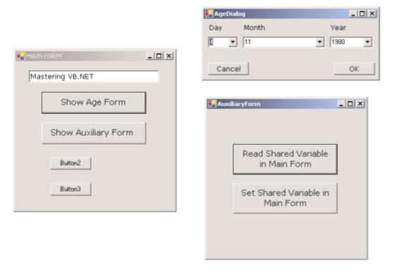
Exercise: The Multiple Forms Project
A main form
An auxiliary form
A dialog box

Slide 14
Arguments
This variable is, in effect, a property of the main form and is declared with the following statements:
Public Shared strProperty As String = “Mastering VB.NET”
The declaration must appear in the form’s declarations section:
Dim FRM As New AuxiliaryForm()

Slide 15
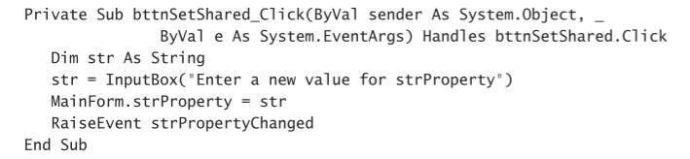
Raising an Event

Slide 16
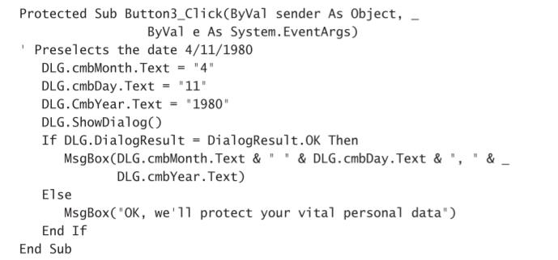
Displaying a Dialog Box and Reading Its Values

Slide 17
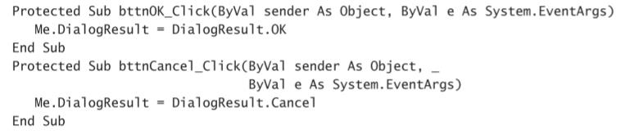
Setting the Dialog Box’s Dialog Result Property

Slide 18
Designing Menus
The Menu Editor
The MenuItem Object’s Properties
Manipulating Menus at Runtime
Iterating a Menu’s Items

Slide 19
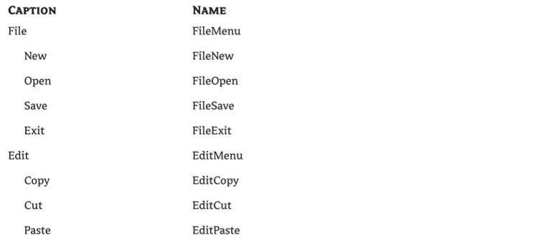
The Captions and Names of the File and Edit Menus

Slide 20
The MenuItem Object’s Properties
Checked
DefaultItem
Enabled
IsParent
Mnemonic
Visible
MDIList

Slide 21
Manipulating Menus at Runtime
Dynamic menus change at runtime to display more or fewer commands
Creating short and long versions of the same menu
Adding and removing menu commands at runtime

Slide 22
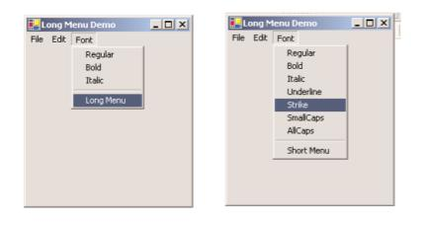
Creating Short and Long Menus
The two versions of the Font menu of the LongMenu application

Slide 23
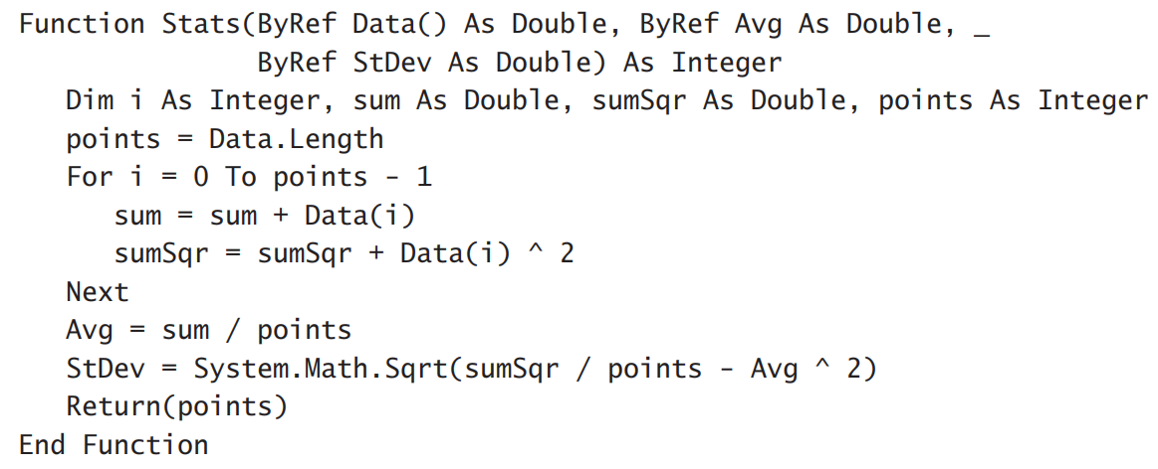
Returning Multiple Values
Stats() function: return Avg and StDev

Slide 24
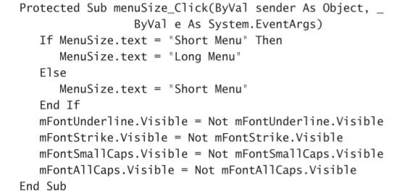
The MenuSize Menu Item’s Click Event

Slide 25
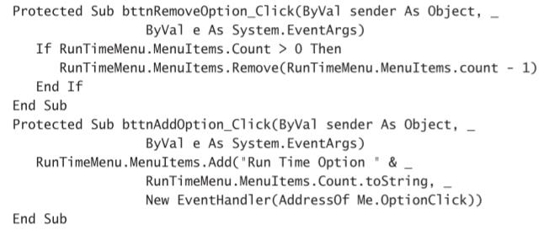
Adding and Removing MenuItems at Runtime

Slide 26
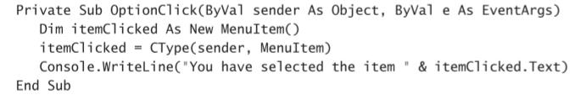
Programming Dynamic Menu Items

Slide 27
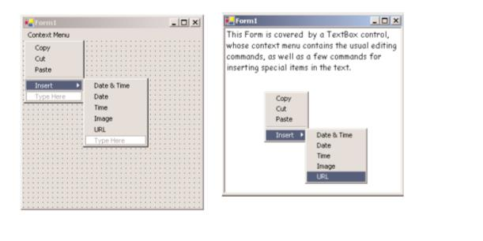
Creating Context Menus
A context menu, (left) at design time and (right) at runtime

Slide 28
Iterating a Menu’s Items
The first command in the File menu can be accessed by the expression
Me.Menu.MenuItems(0).MenuItems(0)
The second command on the same level as the File command (typically, the Edit menu).
Me.Menu.MenuItems(1)
The same items can be accessed by name as well

Slide 29
Exercise: The MapMenu Project
Access the items of a menu from within your application’s code.
A menu, a TextBox control, and a Button
Prints the menu’s structure on the TextBox.

Slide 30
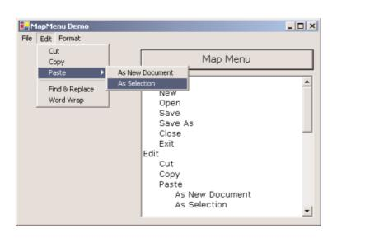
The MapMenu application

Slide 31
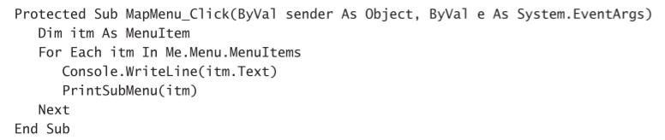
Printing the Top-Level Commands of a Menu

Slide 32
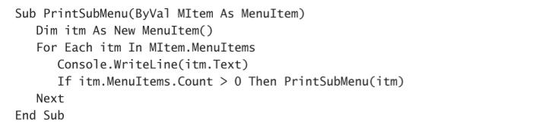
Printing Submenu Items

Slide 33
Building Dynamic Forms at Runtime
The Form.Controls Collection
Add method
Remove method
Count property
All method
Clear method

Slide 34
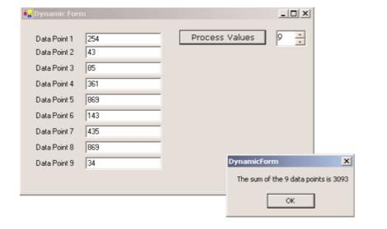
Exercise: The DynamicForm Project

Slide 35
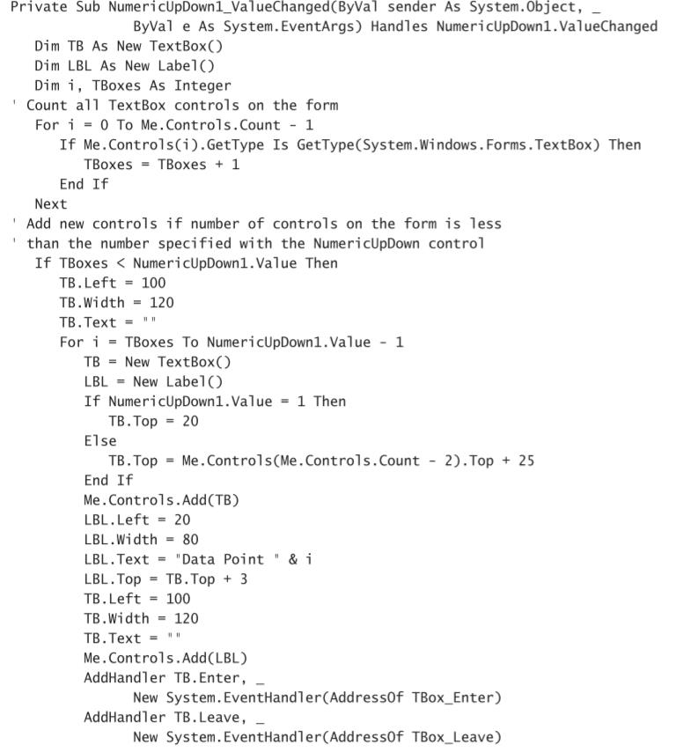
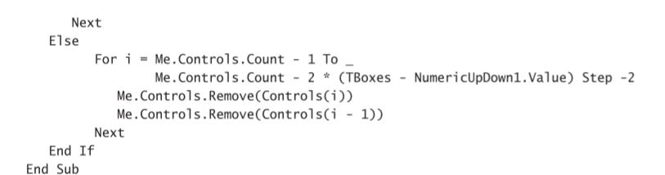
Adding and Removing Controls at Runtime

Slide 36

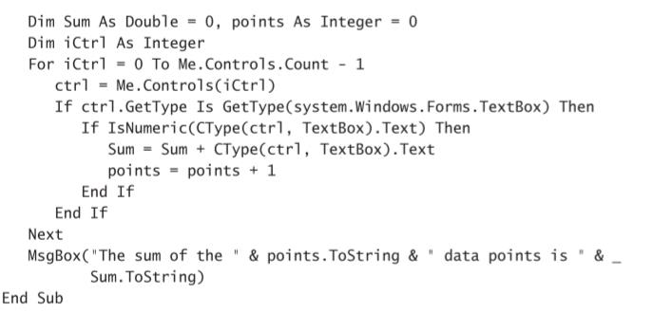
Reading the Controls on the Form
These three properties return a True/False value indicating whether one or more of the control keys were down when the key was pressed.

Slide 37
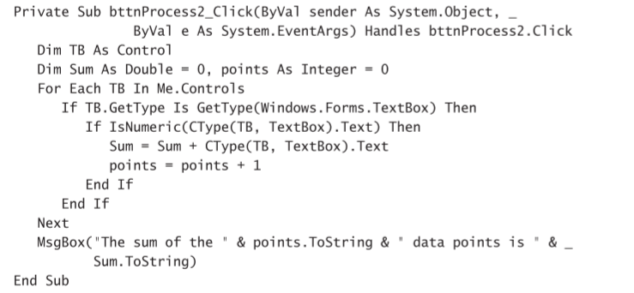
Reading the Controls with a For Each…Next Loop

Slide 38
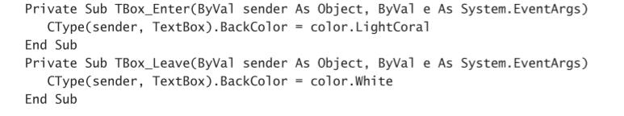
Creating Event Handlers at Runtime
The statement that connects a control’s event to a specific event handler, is the AddHandler statement, whose syntax is:
AddHandler control.event, New System.EventHandler(AddressOf subName)
Event Handlers Added at Runtime

